Slide 1
Aspen simulation: kinetics/reactors
(steam reforming & Haber-Bosch)
CHBE446
Team 2: Jack Capps, Lydia Stricker, Jeffrey Tsao, Christine Zhou

Slide 2
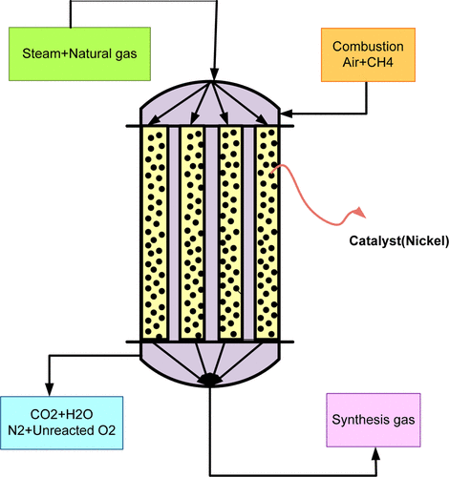
Steam Reforming
Reacting natural gas with steam to produce syngas (hydrogen + CO)
Highly endothermic (ΔH = 206 kJ/mol)
Produces most of the world’s hydrogen
Packed bed reactors with nickel catalyst
700 to 1,000 ºC, 20-30 bar
https://pubs.acs.org/doi/10.1021/ef400026k
Notes:
https://pubs.acs.org/doi/10.1021/ef400026k (image source)

Slide 3
Haber-Bosch Process
Main industrial process for ammonia production
Exothermic (ΔH = -92 kJ/mol)
Reverse reaction speeds up greatly
at high temperatures
Low temperature, high pressure
for higher yield
https://www.bobvila.com/articles/types-of-fertilizer/
Notes:
https://www.bobvila.com/articles/types-of-fertilizer/ (image source)

Slide 4
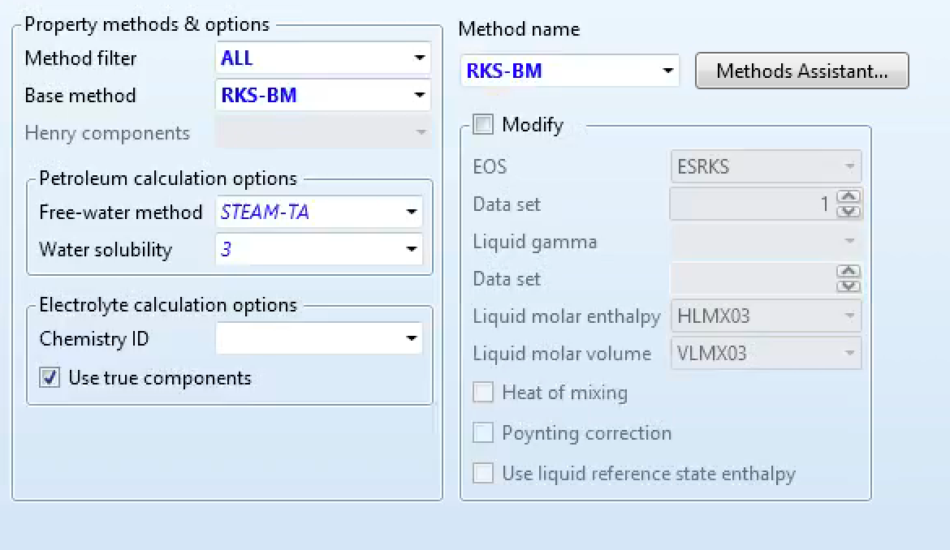
Haber-Bosch Process—Aspen
RKS-BM method is recommended for gas-processing, refinery, and petrochemical applications

Slide 5
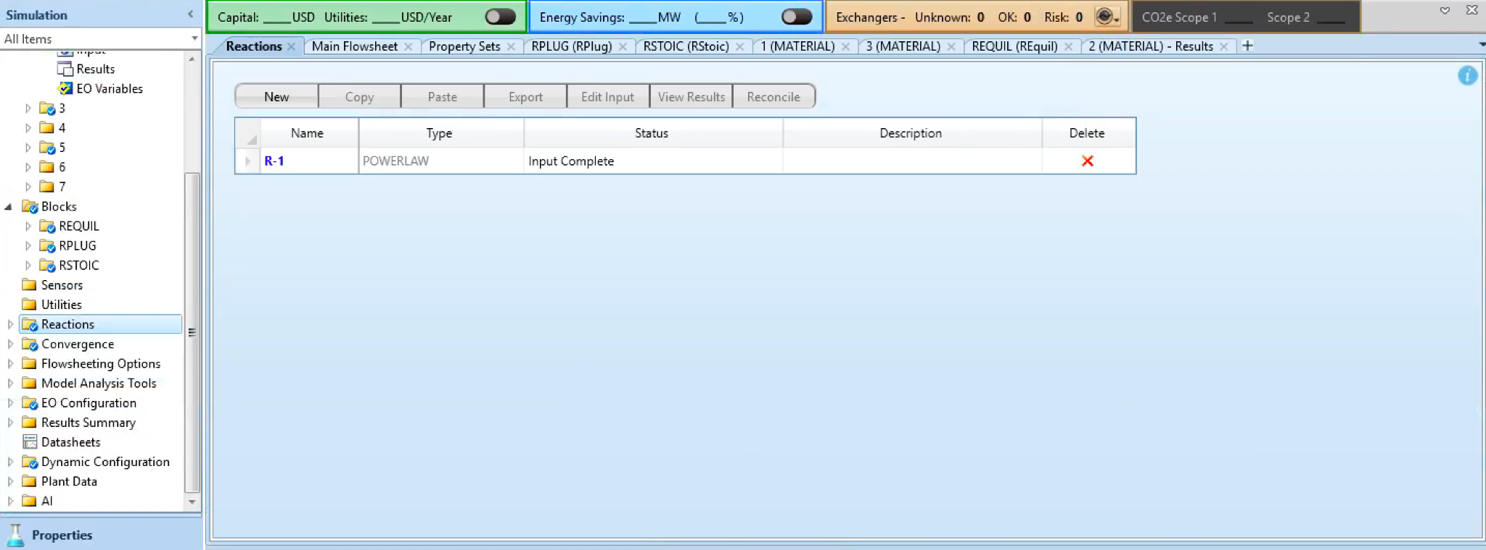
Haber-Bosch Process—Aspen

Slide 6
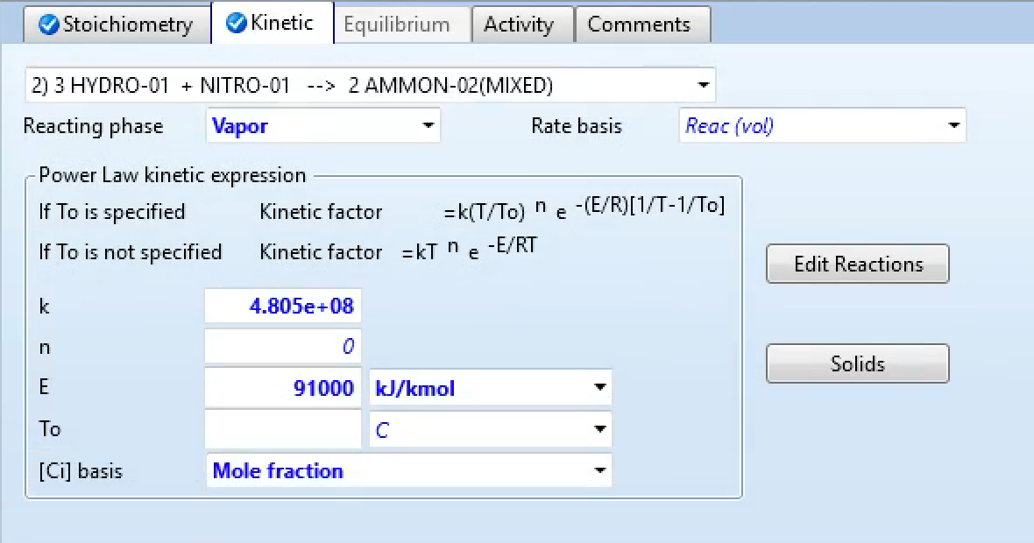
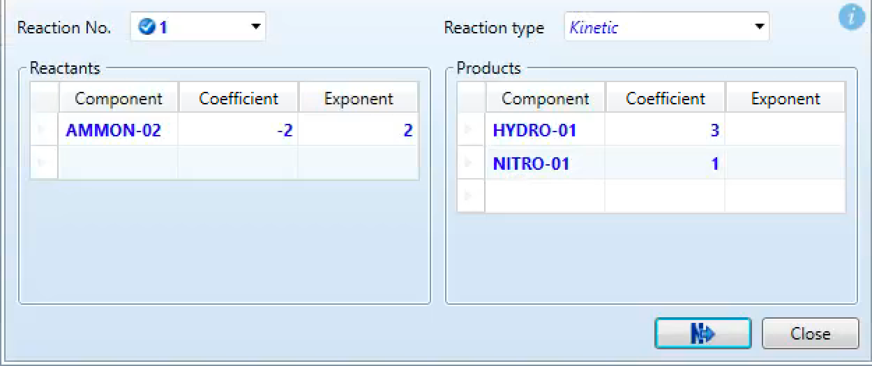
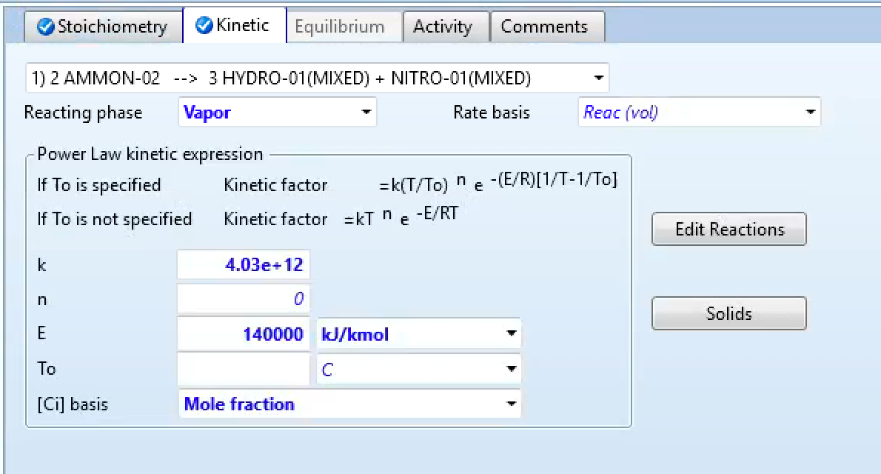
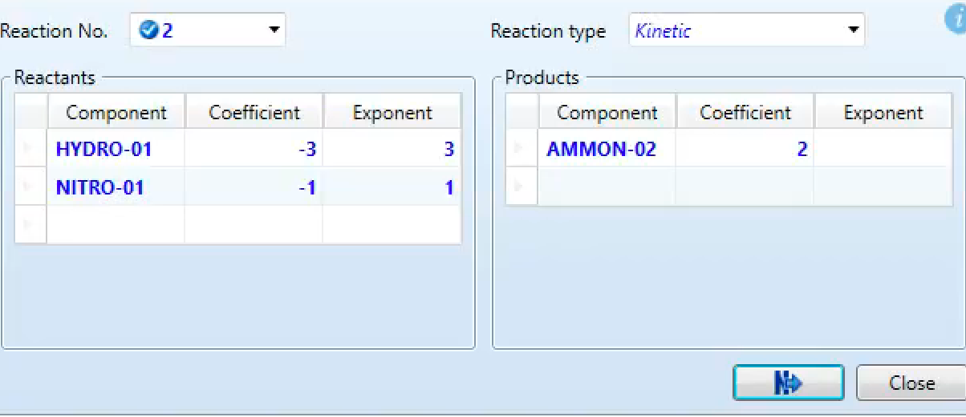
Haber-Bosch Process—Aspen
Notes:
K = rate constant
E = activation energy
Values taken from the mini project we did in 444

Slide 7
RPlug Reactor
PFR
Known stoichiometry and kinetics
1, 2, or 3 phases

Slide 8
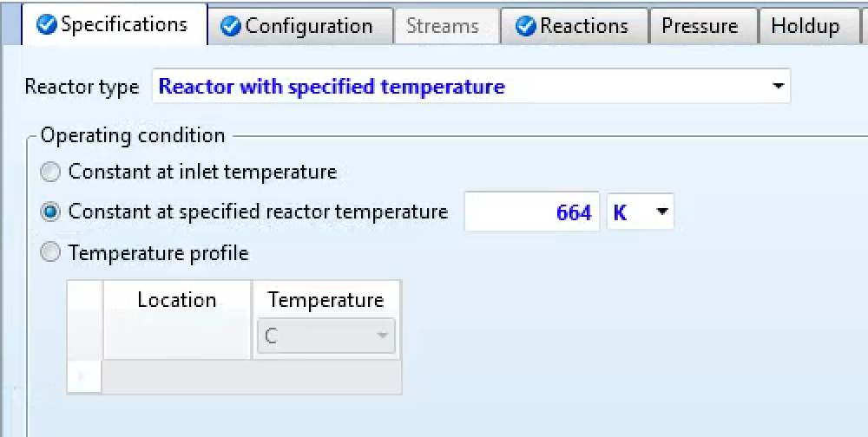
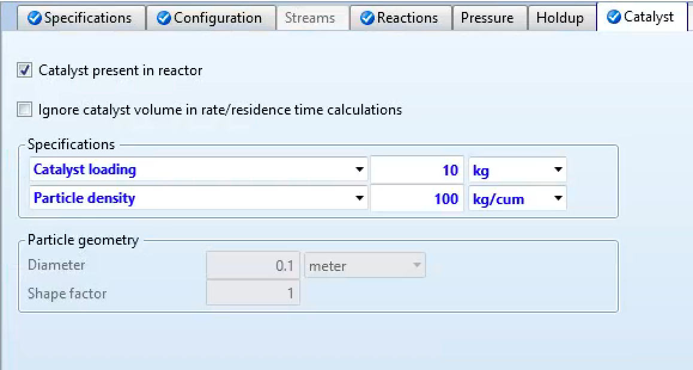
RPlug Reactor—Conditions

Slide 9
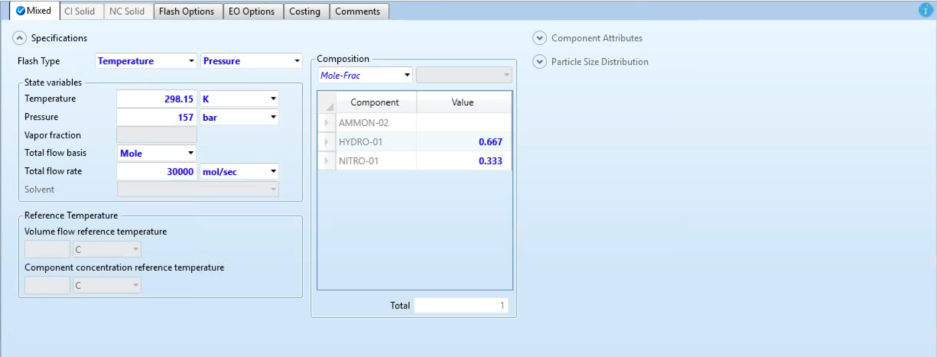
RPlug Reactor—Inlet Stream

Slide 10
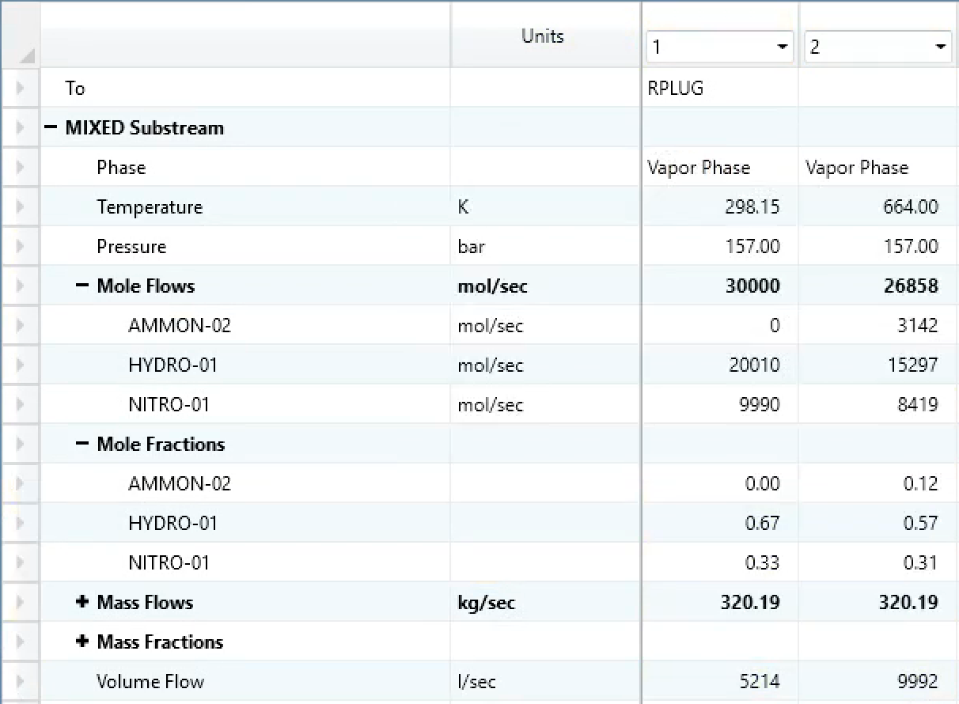
RPlug Reactor—Results
Cooling jacket, if used, is insufficient to cool reactor to low enough temperature due to highly exothermic reaction
Results in low conversion in reality
Use instead…

Slide 11
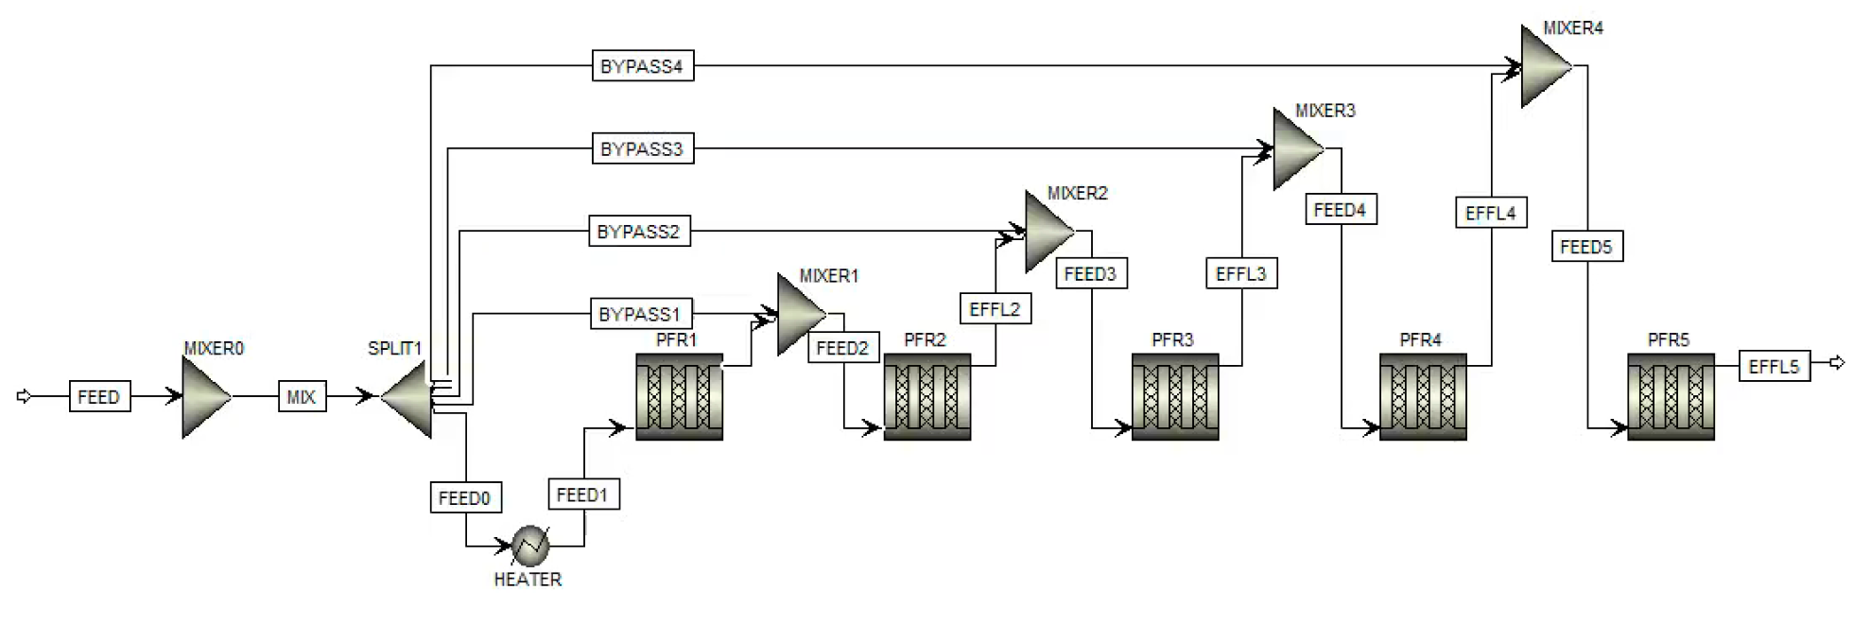
Cold Shot Method
Split feed into “cold shots” which are injected into the PFR at various intervals
More variables to optimize but more effective cooling

Slide 12
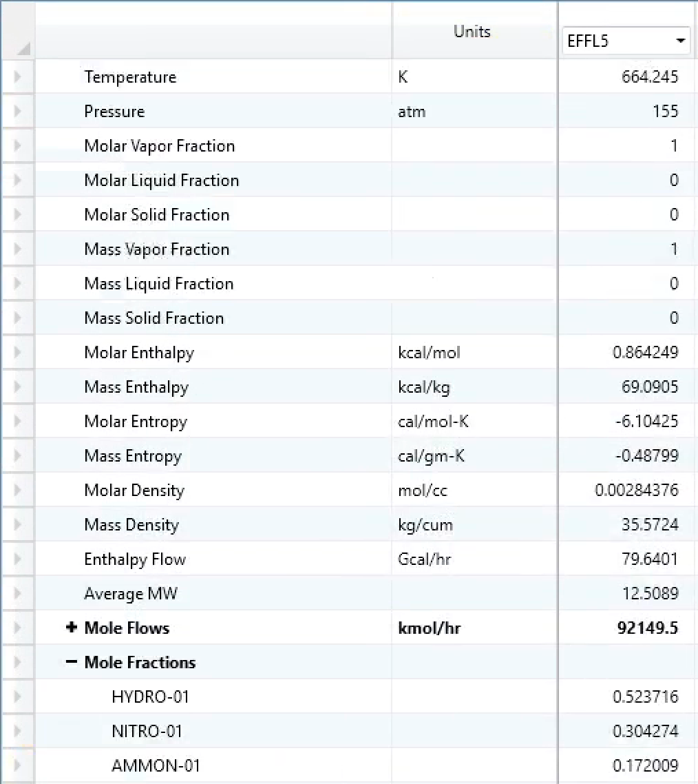
Cold Shot Method—Results
Higher conversion!
Able to operate at a lower temperature

Slide 13
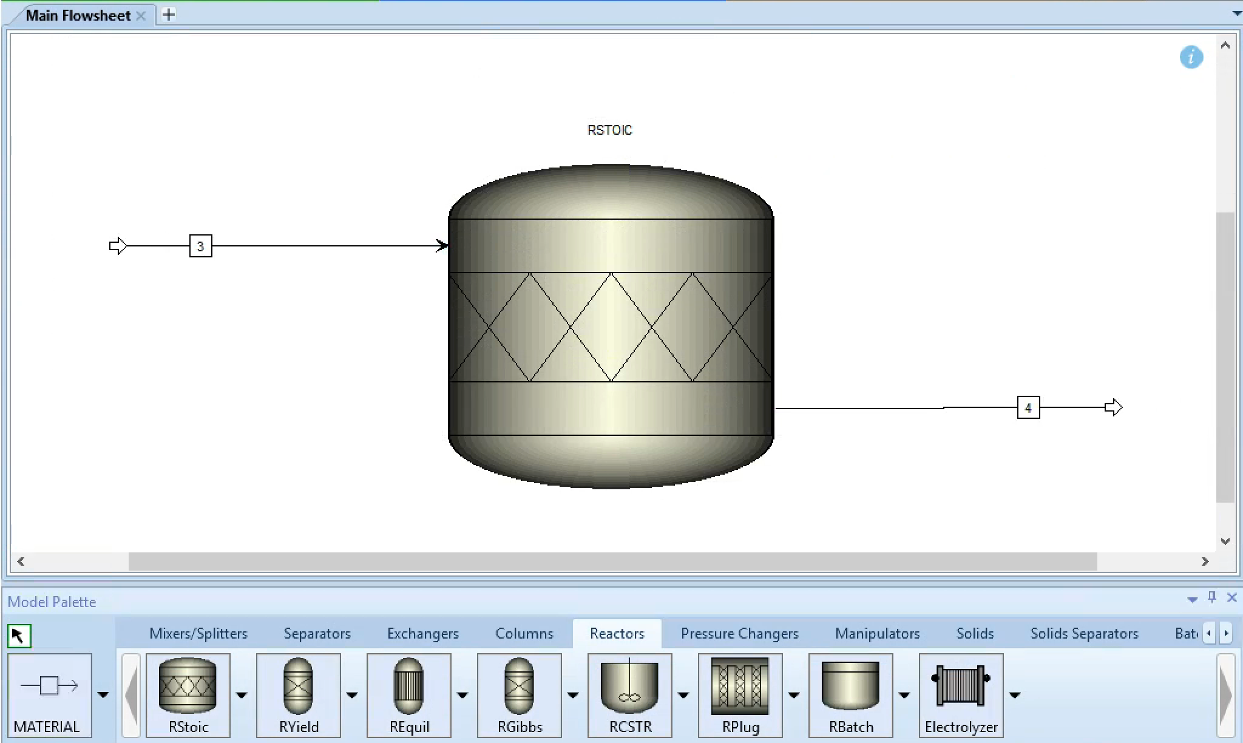
RStoic Reactor
Stoichiometric reactor
Specified extent of reaction or conversion
Kinetics are unknown or unimportant
Stoichiometry is known

Slide 14
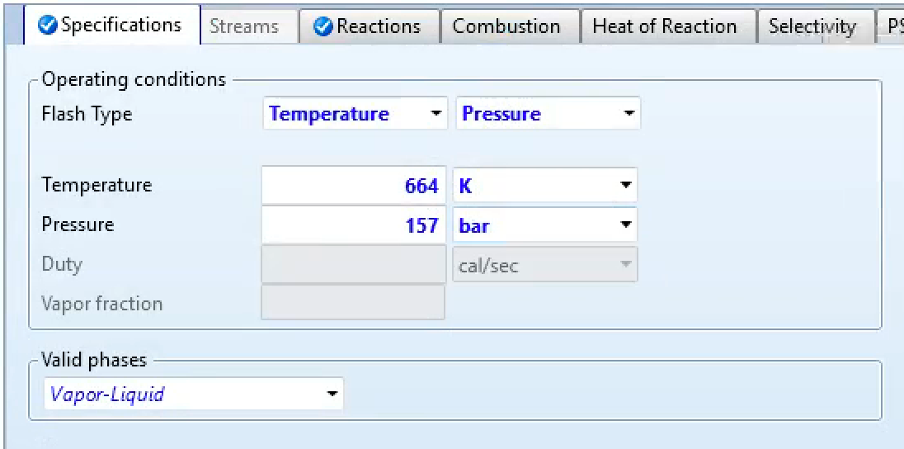
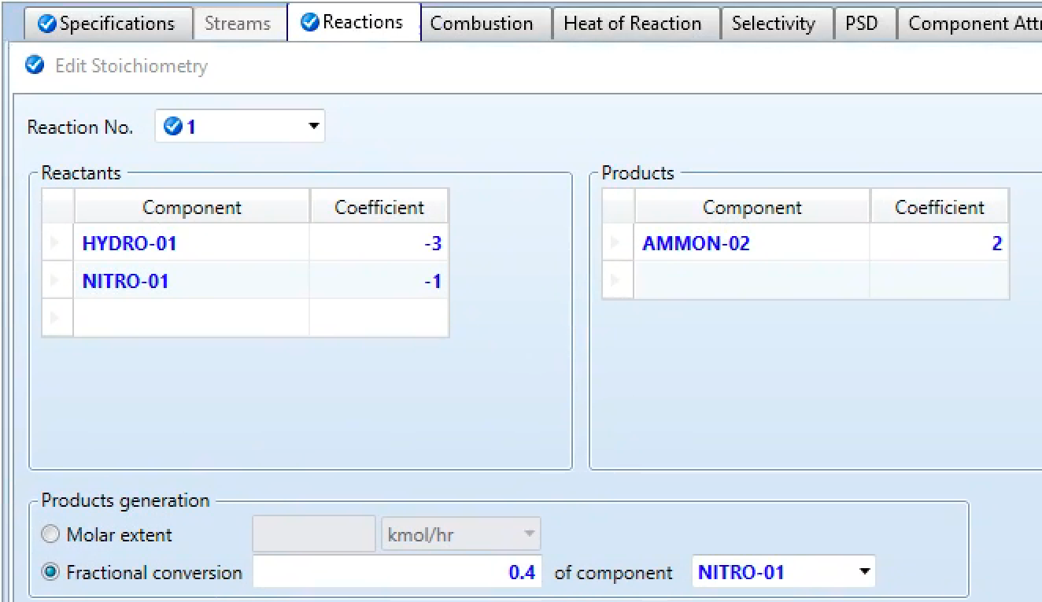
RStoic Reactor—Conditions

Slide 15
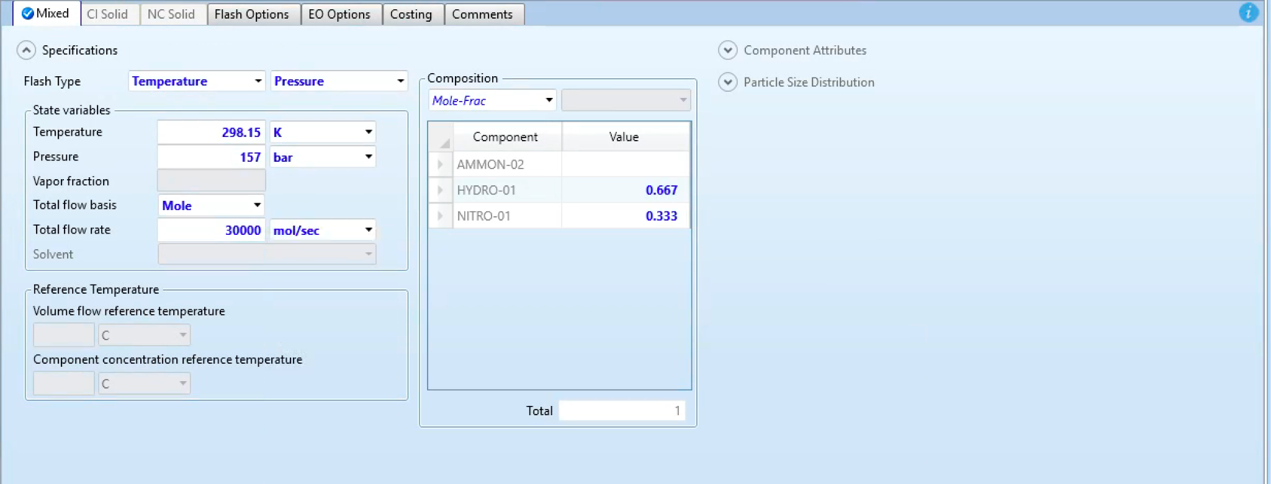
RStoic Reactor—Inlet Stream
Same Conditions as before!

Slide 16
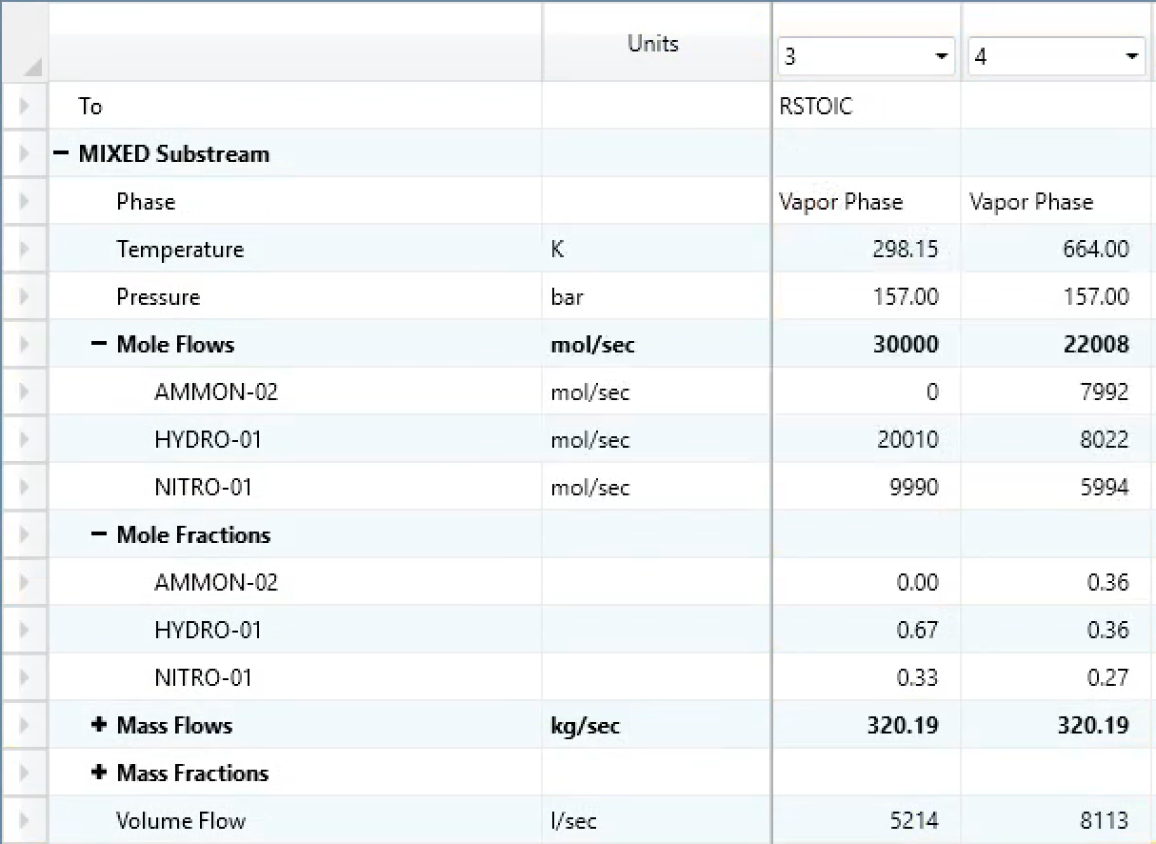
RStoic Reactor—Results
Higher conversion
For modeling a real reaction, a stoichiometric reactor is not as accurate as RPlug… not using kinetics (just a model)

Slide 17
Steam Reforming—Aspen
RKS-BM method is recommended for gas-processing, refinery, and petrochemical applications

Slide 18
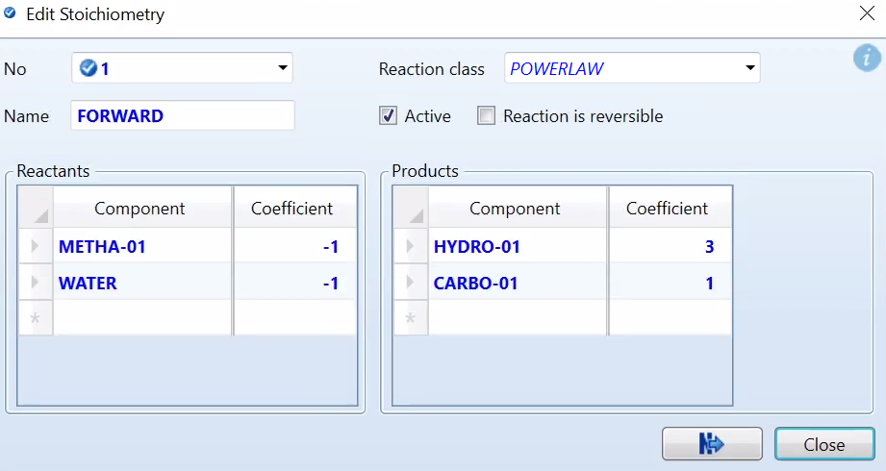
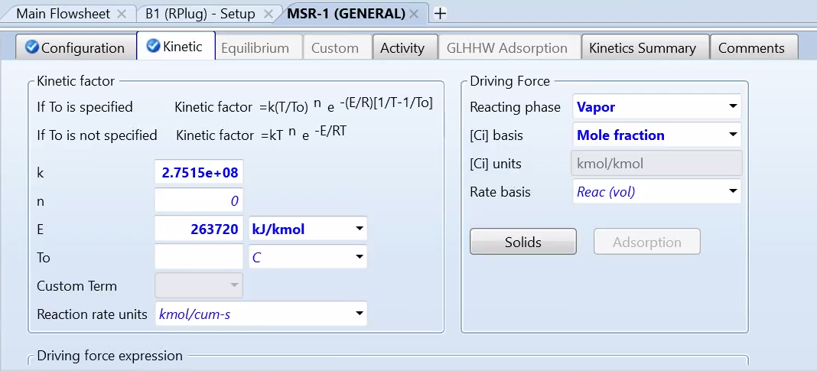
Steam Reforming—Aspen
Notes:
Kinetics values determined from NSW paper

Slide 19
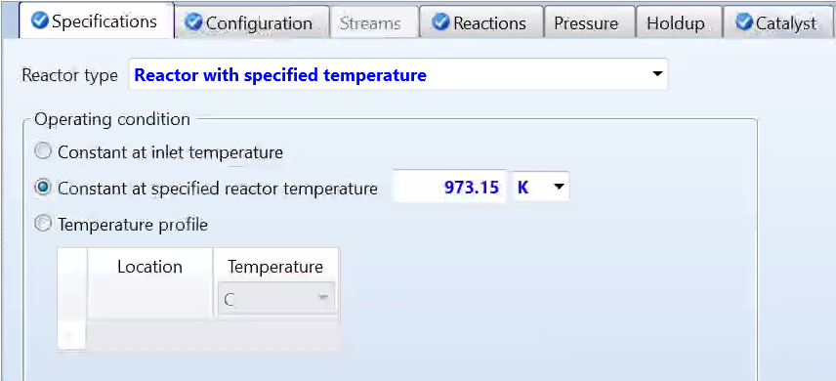
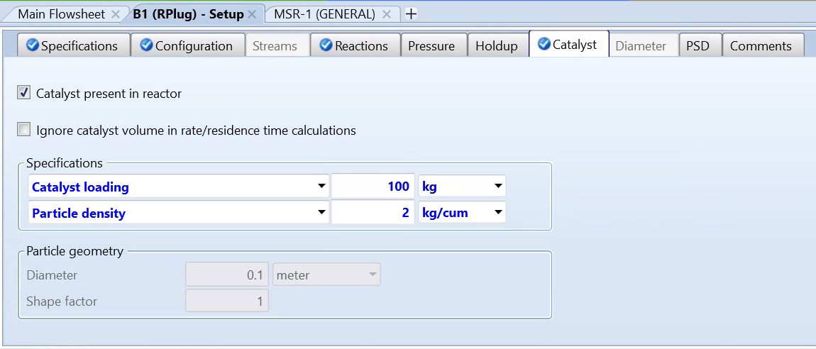
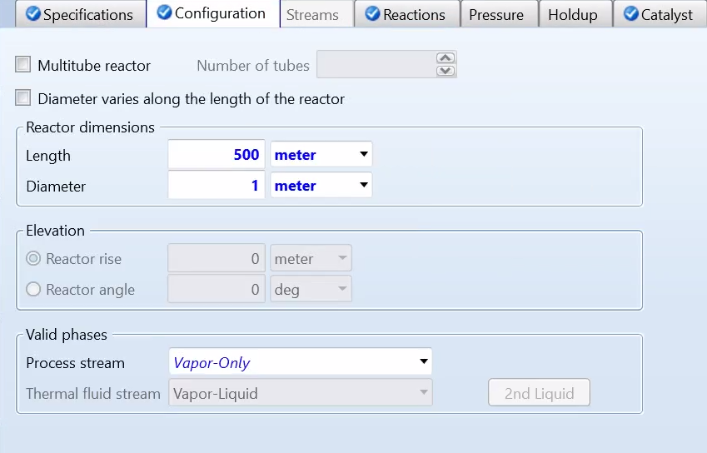
RPlug Reactor—Conditions

Slide 20
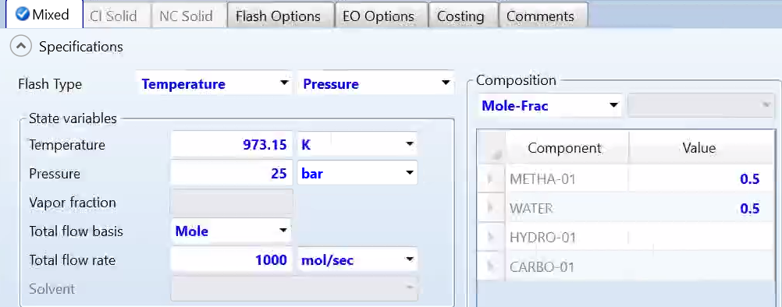
Inlet Stream Conditions

Slide 21
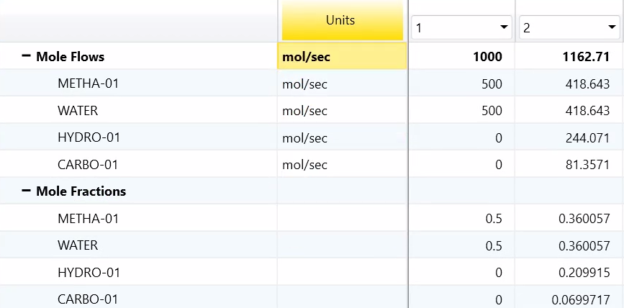
RPlug Reactor—Results
Notes:
Low conversion, could be improved by increasing the temperature, messing with catalyst density, total catalyst mass, arbitrary kinetic constant

Slide 22
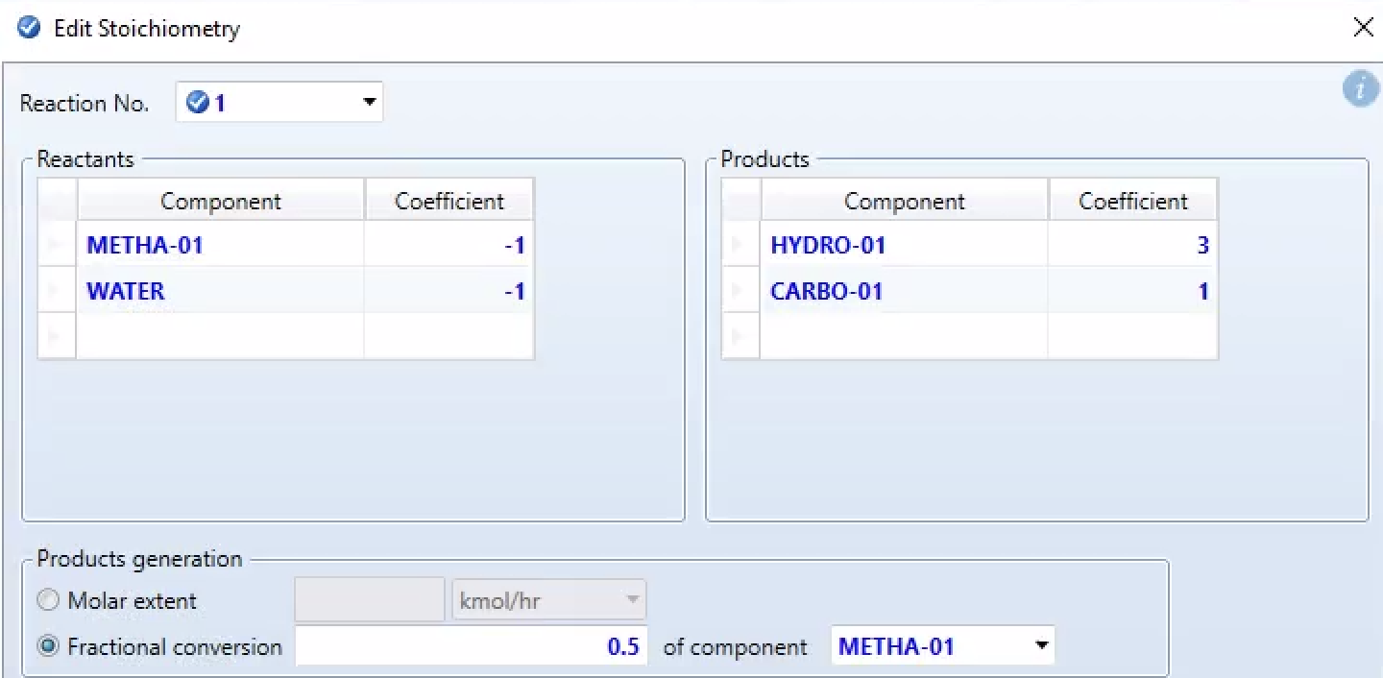
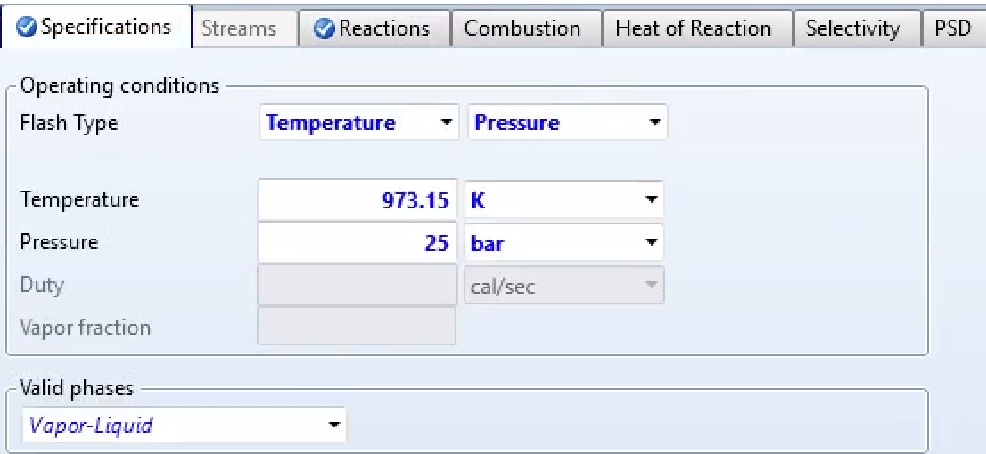
RStoic Reactor Conditions

Slide 23
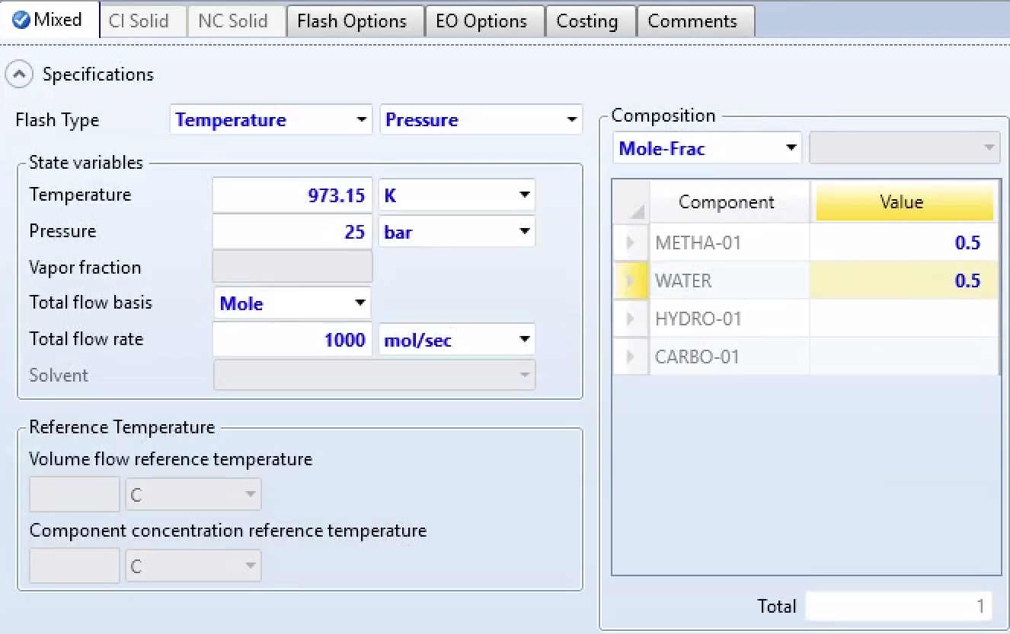
RStoic Inlet Stream Conditions

Slide 24
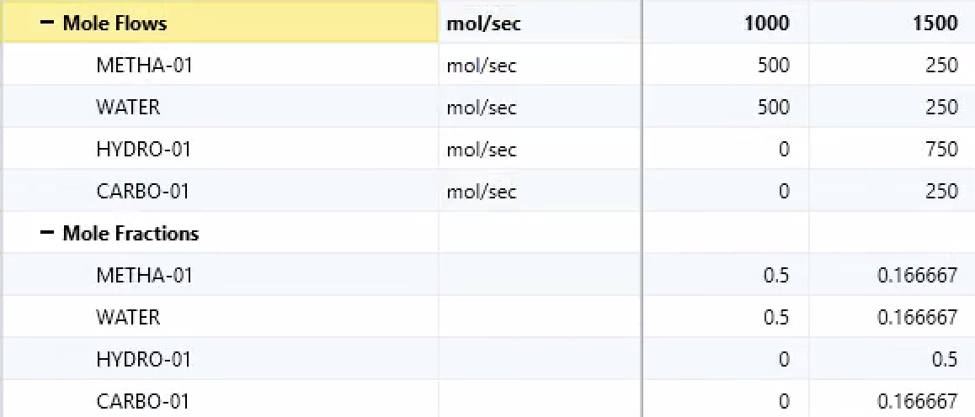
RStoic Results

Slide 25
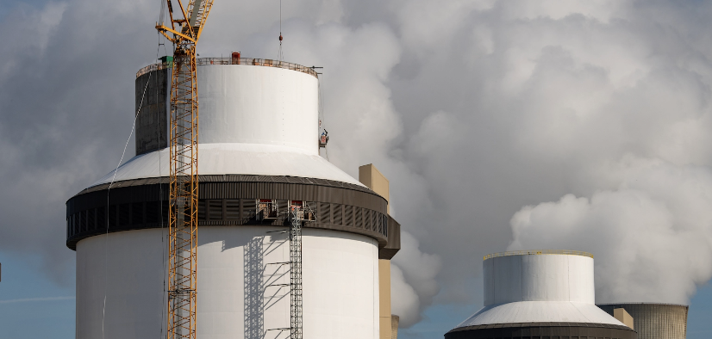
Questions?

Slide 26
References
Amran, U. I.; Ahmad, A.; Othman, M. R. Kinetic Based Simulation of Methane Steam Reforming and Water Gas Shift for Hydrogen Production Using Aspen Plus. Chemical Engineering Transactions 2017, 56, 1681–1686. https://doi.org/10.3303/cet1756281.
Aspen Technology, Inc. Aspen Plus Ammonia Model; 2015.
Clark, J. The Haber Process for the manufacture of ammonia. https://www.chemguide.co.uk/physical/equilibria/haber.html.
Rahimpour, M. R.; Hesami, M.; Saidi, M.; Jahanmiri, A.; Farniaei, M.; Abbasi, M. Methane Steam Reforming Thermally Coupled with Fuel Combustion: Application of Chemical Looping Concept as a Novel Technology. Energy & Fuels 2013, 27 (4), 2351–2362. https://doi.org/10.1021/ef400026k.

